Slide 1
Predicting Compound-Protein Interactions From Statistical Learning Perspective
PhD Candidate: Songpeng Zu
Advisor: Prof. Shao Li
2015-09-01

Slide 2
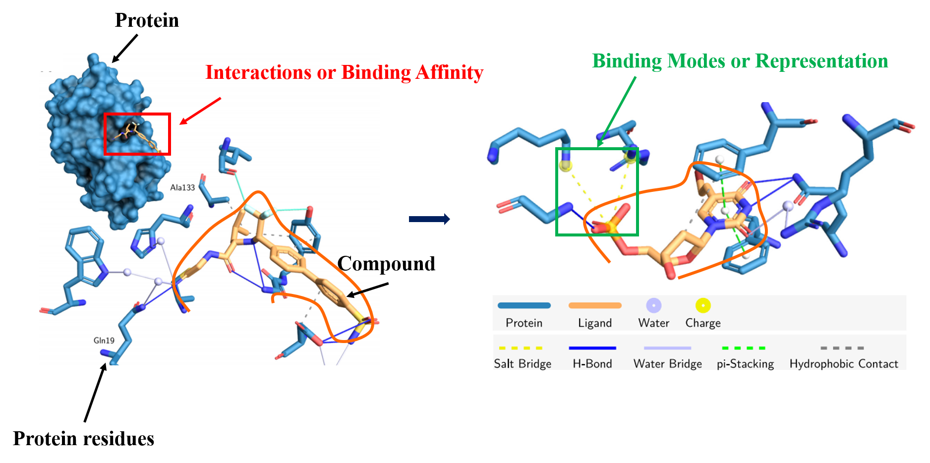
Introduction
Salentin, S., et al., PLIP: fully automated protein–ligand interaction profiler. Nucleic Acids Res. 2015 43: W443-W447.

Slide 3
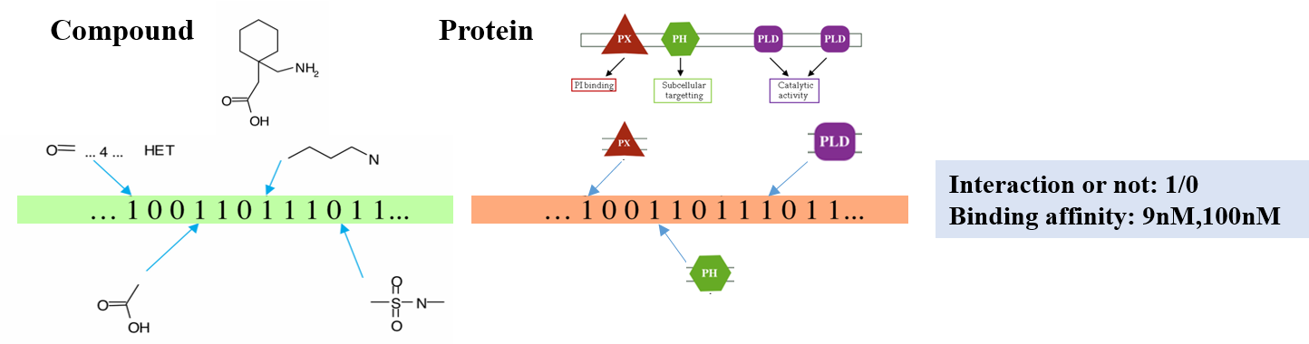
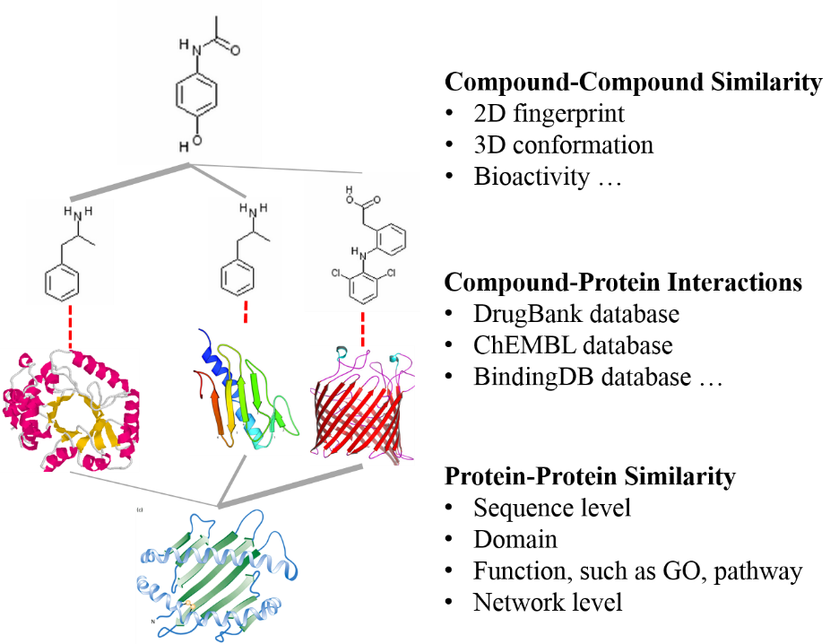
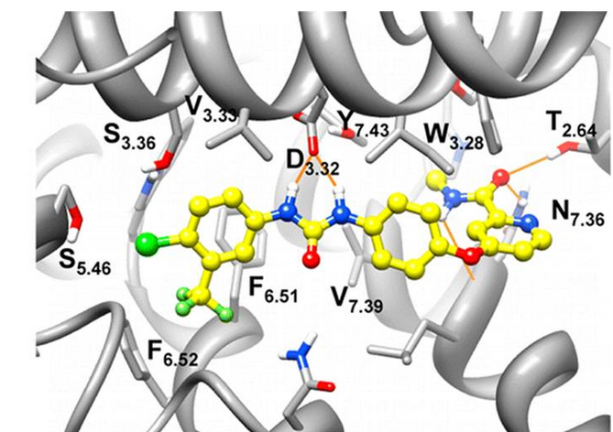
How to model CPIs
Chemoinformatics
Similarity Network
Molecular Dynamics

Slide 4
Content
Introduction on Compound-Protein Interactions (CPIs)
Prediction on CPIs from Statistical Learning.
Inference on the latent features from CPIs by EM algorithm
Quantitative prediction on CPIs by multi-task learning
Graph partition based prediction on CPIs
Application
Predicting RIP3 inhibitors
Ginkgolide’s bioactivity study
Summary

Slide 5
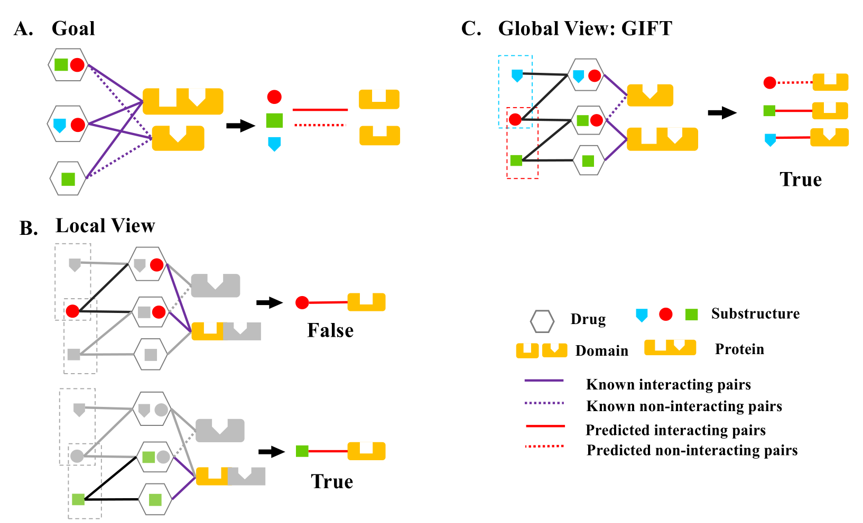
Inference on the latent features
Zu S., et al., Global optimization-based inference of chemogenomic features from drug–target interactions. Bioinformatics. 2015 31 (15): 2523-2529.

Slide 6
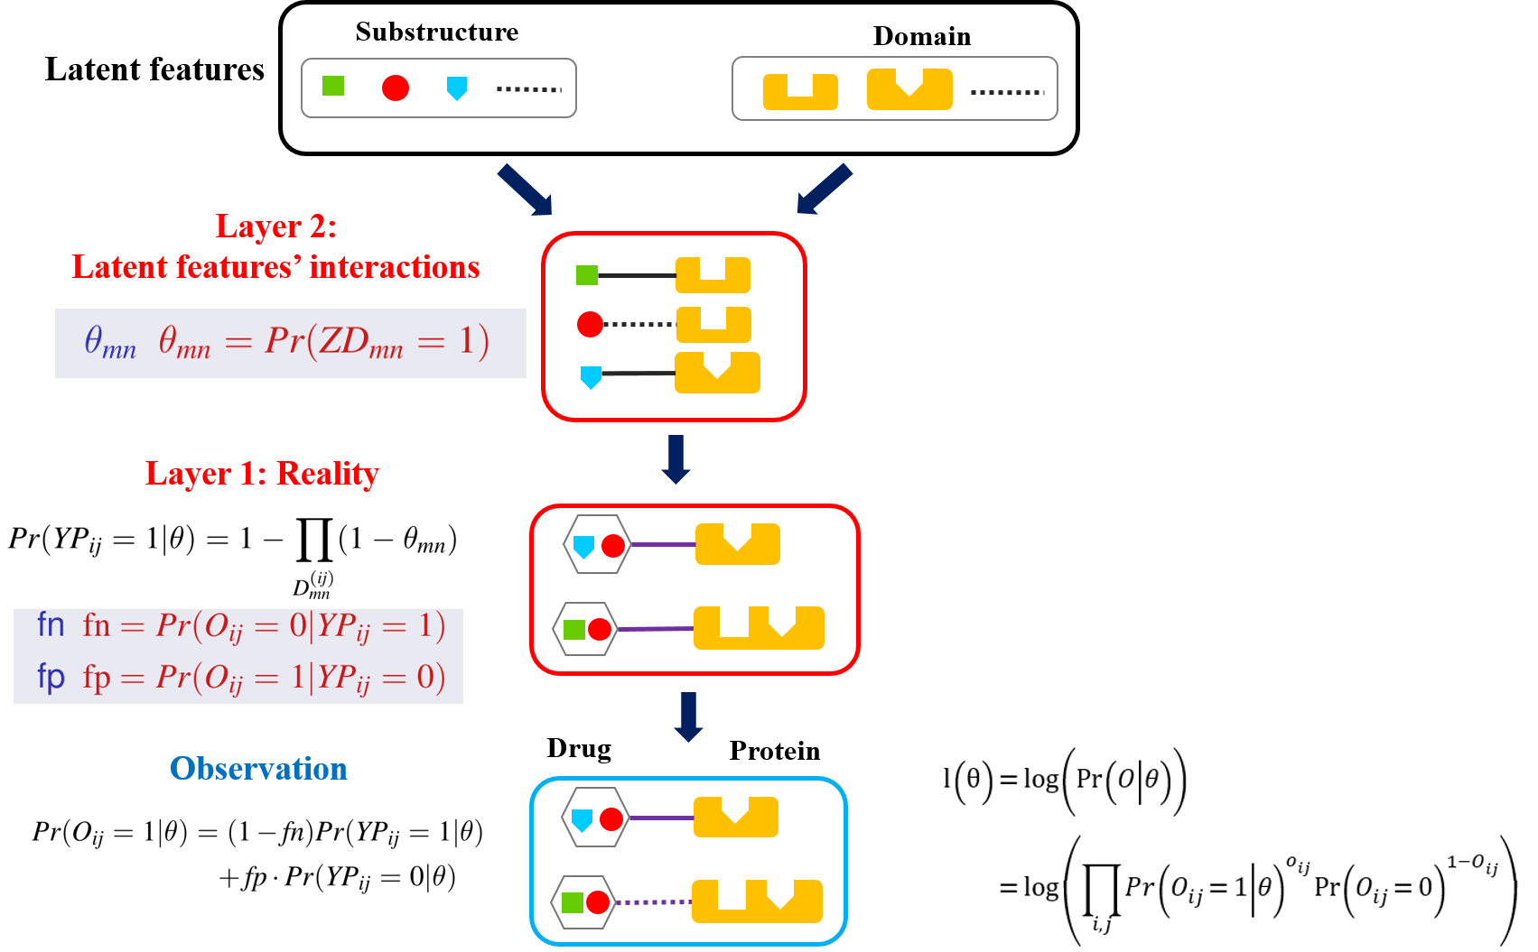
Inference on the latent features

Slide 7
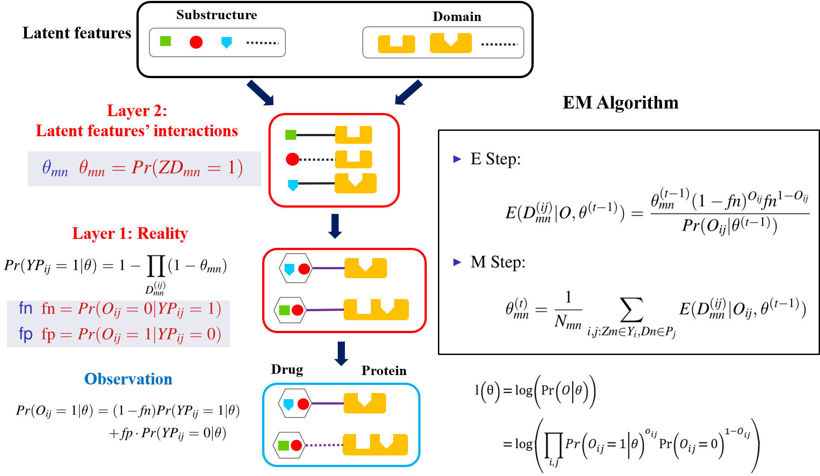
Inference on the latent features

Slide 8
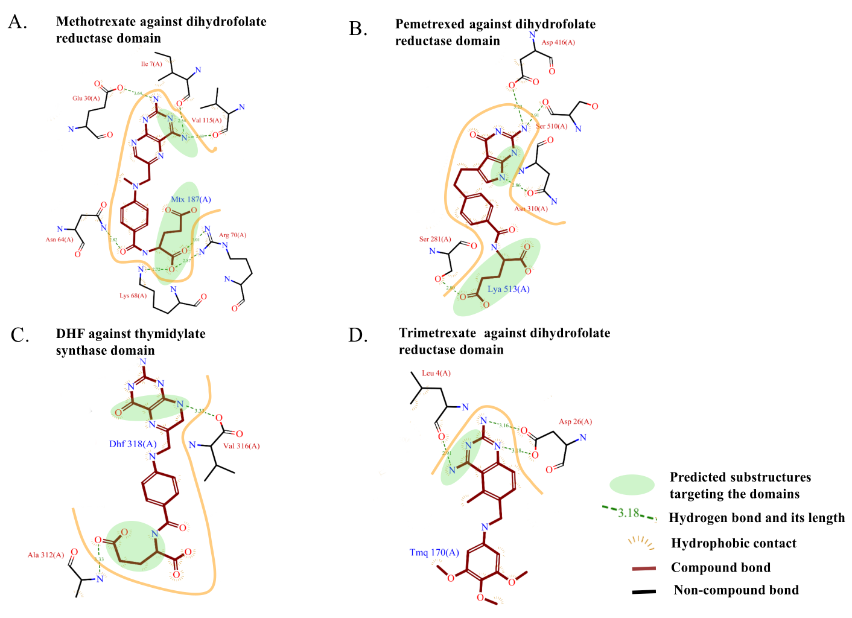
Inference on the latent features

Slide 9
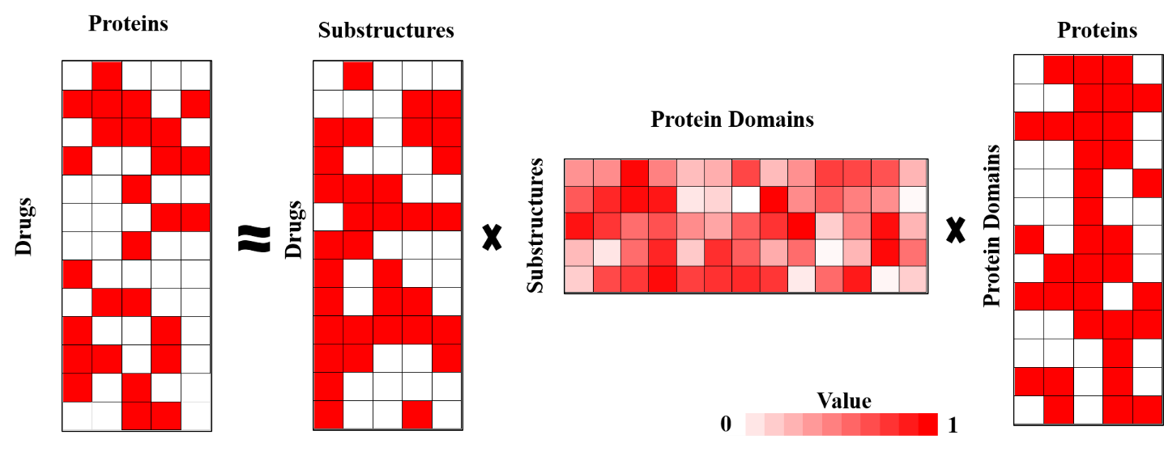
Discussion
It can be roughly treated as an approximation below.

Slide 10
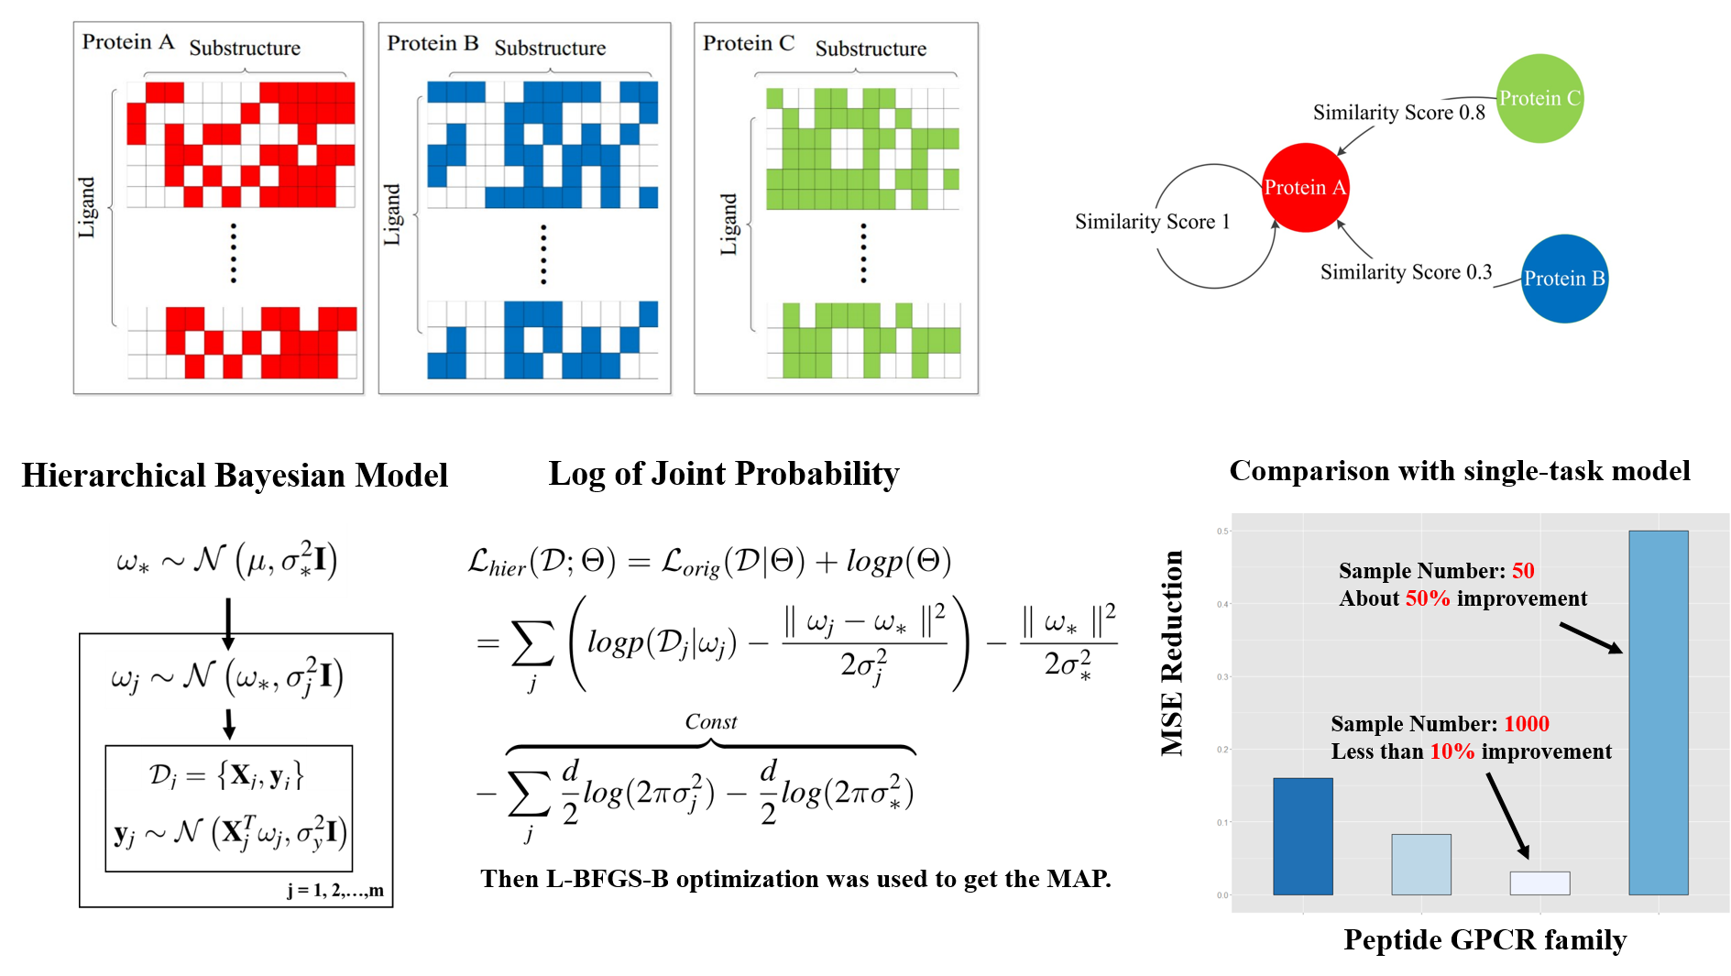
Quantitative prediction multi-task learning

Slide 11
Quantitative prediction multi-task learning

Slide 12
Quantitative prediction multi-task learning

Slide 13
Quantitative prediction multi-task learning

Slide 14
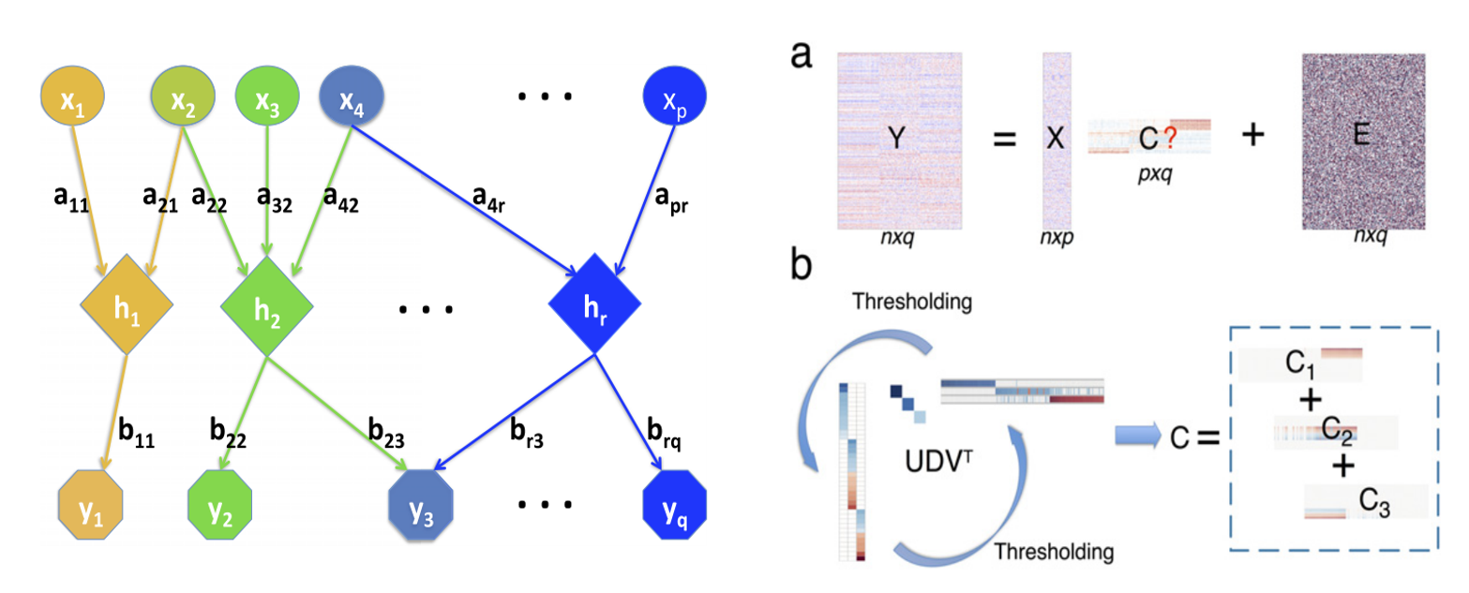
Quantitative prediction multi-task learning
Structure Learning
Xin Ma, Luo Xiao, and Wing Hung Wong. PNAS, 2014

Slide 15
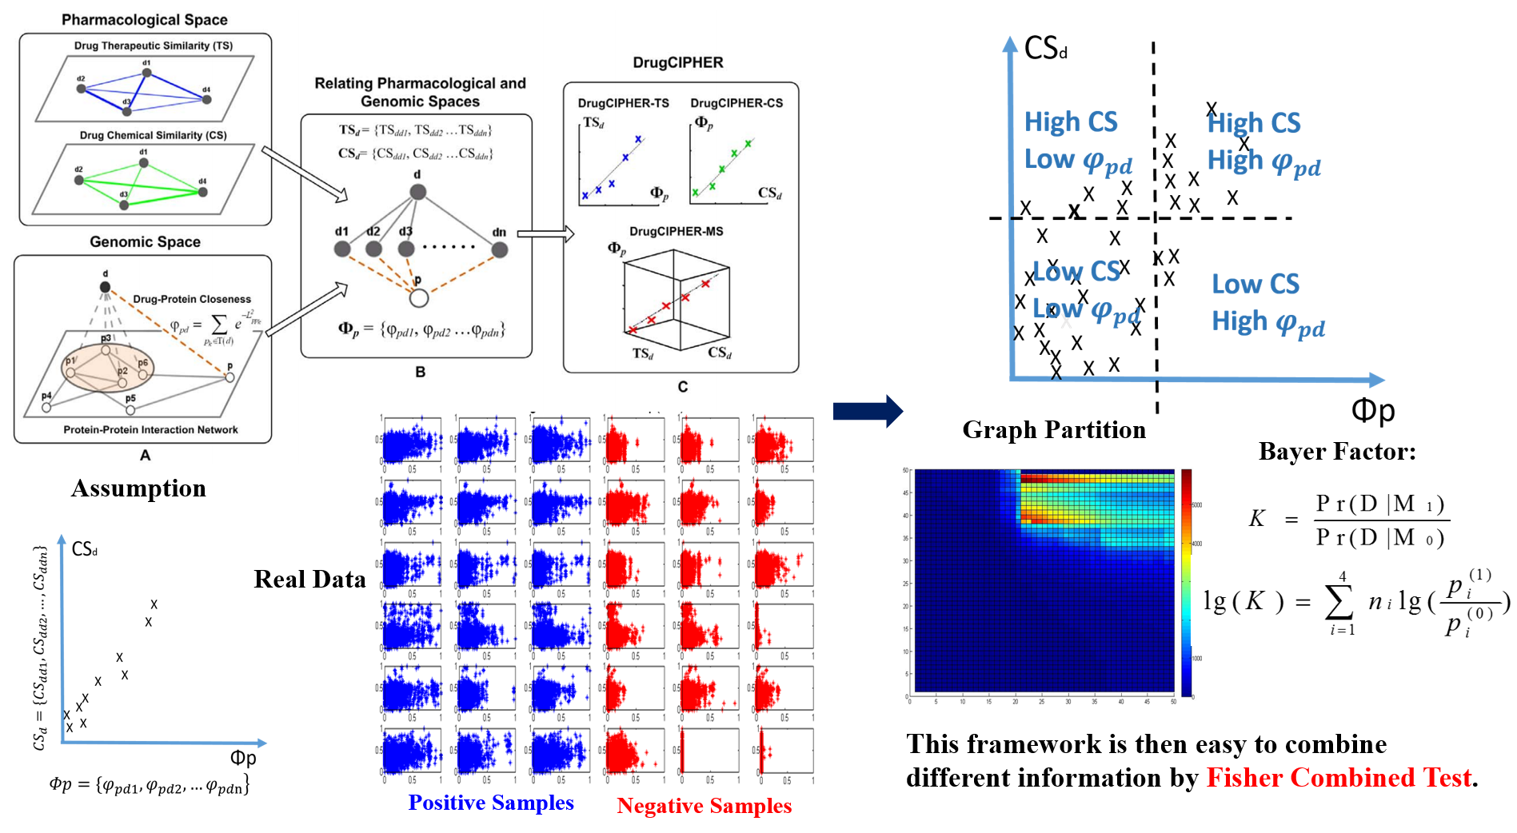
Graph partition based prediction on CPIs

Slide 16
Graph partition based prediction on CPIs

Slide 17
Graph partition based prediction on CPIs

Slide 18
Graph partition based prediction on CPIs

Slide 19
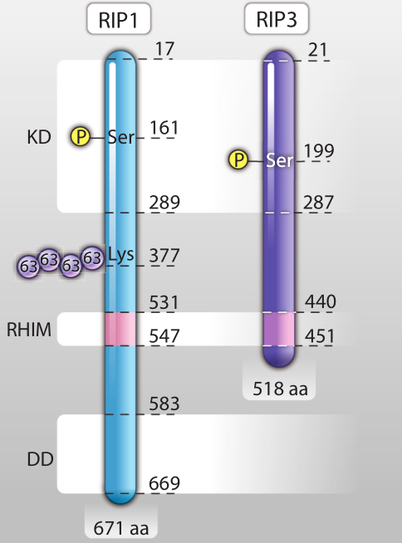
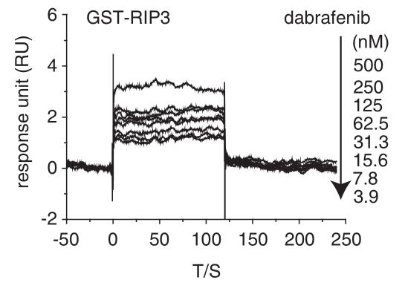
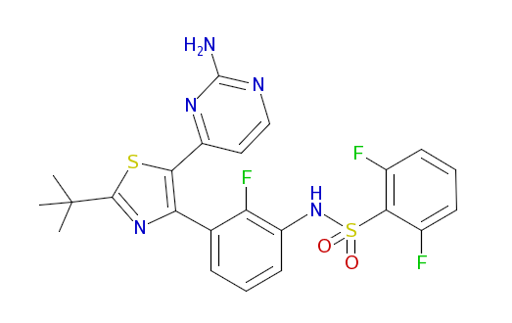
Application: Predicting RIP3 inhibitors.
Essential for necroptosis, a programmed cell death process in response to death-inducing TNF-alpha family members.
Few compounds against it.
Dabrafenib
Zhuang, D.W., et al., RIP3, an Energy Metabolism Regulator That Switches TNF-Induced Cell Death from Apoptosis to Necrosis. Science, 2009. 10(1126): p. 325-332.
Li J-X., et al., The B-Raf V600E inhibitor dabrafenib selectively inhibits RIP3 and alleviates acetaminophen-induced liver injury. Cell Death and Disease (2014) 5, e1278

Slide 20
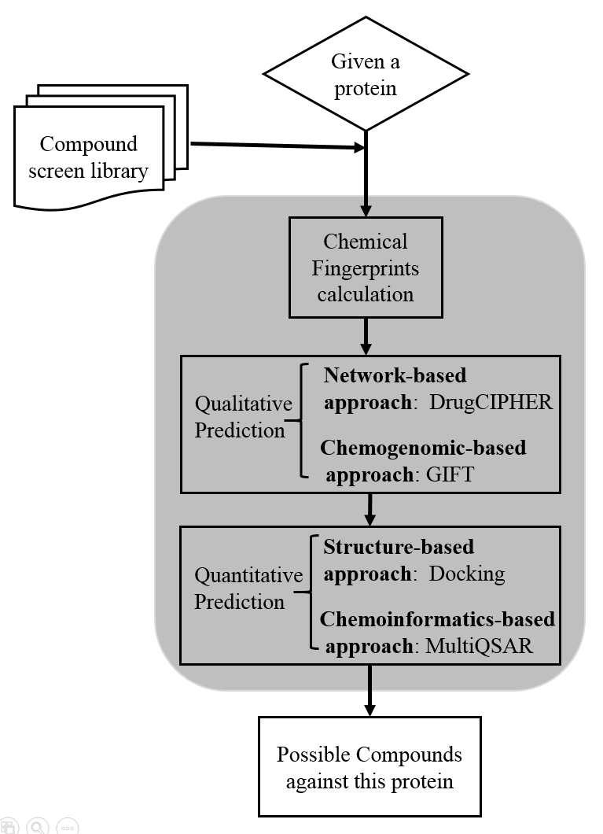
Our Computational Procedure
Here RIP3
HerbBioMap: 4000
DrugBank: 6800
ChEMBL: 149384
HerbBioMap: 136 left
DrugBank: 345 left
ChEMBL: 1975 left
Only drugCIPHER is used here
Sequence alignment and homology modeling
Compounds’ 3D construction
Binding Pocket Selection
Docking
Result Checking
- Binding energy
- Binding mode
HerbBioMap: 2 left
DrugBank: 2 left
ChEMBL: 29 left

Slide 21
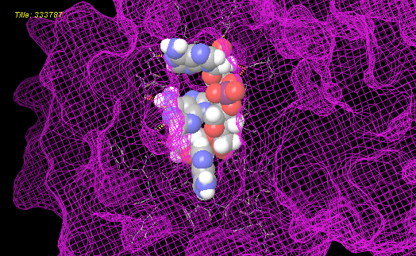
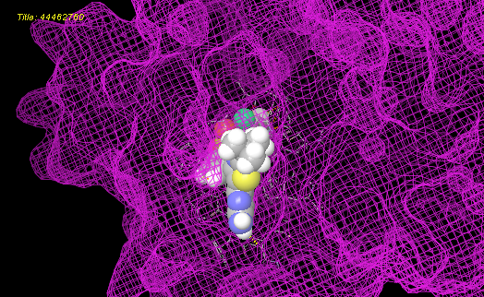
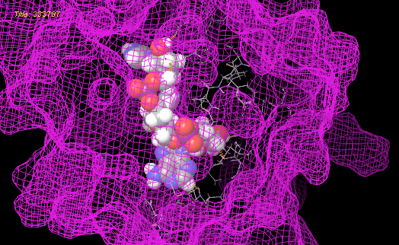
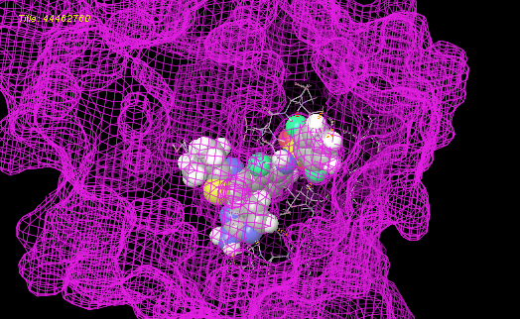


Results
Triple-Co
Positive Control: dabrafenib
$${90}^{°}$$
$${90}^{°}$$

Slide 22
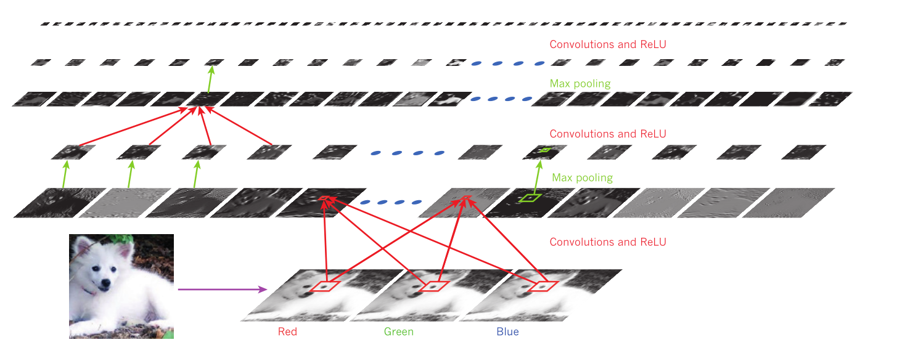
Summary
Prediction on CPIs:
Discover the latent features: an EM algorithm framework
Quantitative prediction: a multi-task learning procedure
Similarity-based Graph Partition
Further Direction:
Representation Learning, especially deep learning.
Yann LeCun, Yoshua Bengio & Geoffrey Hinton. Nature, 2015

Slide 23
Thanks for your listening.
Thanks for Prof. Shao Li’s instruction.
Thanks for Xin Wang for the Graph Partition project.
Thanks for Qingyang Ding for the RIP3 inhibitor project.
Thanks for Prof. Tim Chen’s many advices on the GIFT project.
Thanks for Dr. Jiexing Wu, Prof. Rui Jiang and Prof. Jun S. Liu’s on MultiQSAR project.
Thanks for Prof. Wing Hong Wong’s suggestions on the representation learning.

